Slide 1
Network traffic from a botnet
id,length,ttl,source,destination,data
511,48,128,0,1,044c0050c721033b000000007002faf0be560000020405b401010402
514,48,128,0,1,044c0050c721033b000000007002faf0be560000020405b401010402
515,48,128,0,1,044c0050c721033b000000007002faf0be560000020405b401010402
527,48,128,0,2,044f005003a2c741000000007002faf09b2d0000020405b401010402
530,48,128,0,2,044f005003a2c741000000007002faf09b2d0000020405b401010402
531,48,128,0,2,044f005003a2c741000000007002faf09b2d0000020405b401010402
543,48,128,0,3,045200500970750c000000007002faf0d89a0000020405b401010402
546,48,128,0,3,045200500970750c000000007002faf0d89a0000020405b401010402
547,48,128,0,3,045200500970750c000000007002faf0d89a0000020405b401010402
559,48,128,0,4,04550050defc54bf000000007002faf0b9690000020405b401010402
562,48,128,0,4,04550050defc54bf000000007002faf0b9690000020405b401010402
563,48,128,0,4,04550050defc54bf000000007002faf0b9690000020405b401010402...

Slide 2
Network traffic from a botnet
id,length,ttl,source,destination,data
511,48,128,0,1,044c0050c721033b000000007002faf0be560000020405b401010402
514,48,128,0,1,044c0050c721033b000000007002faf0be560000020405b401010402
515,48,128,0,1,044c0050c721033b000000007002faf0be560000020405b401010402
527,48,128,0,2,044f005003a2c741000000007002faf09b2d0000020405b401010402
530,48,128,0,2,044f005003a2c741000000007002faf09b2d0000020405b401010402
531,48,128,0,2,044f005003a2c741000000007002faf09b2d0000020405b401010402
543,48,128,0,3,045200500970750c000000007002faf0d89a0000020405b401010402
546,48,128,0,3,045200500970750c000000007002faf0d89a0000020405b401010402
547,48,128,0,3,045200500970750c000000007002faf0d89a0000020405b401010402
559,48,128,0,4,04550050defc54bf000000007002faf0b9690000020405b401010402
562,48,128,0,4,04550050defc54bf000000007002faf0b9690000020405b401010402
563,48,128,0,4,04550050defc54bf000000007002faf0b9690000020405b401010402
...
Structure is clearly present
Seems a waste to use unstructured methods…

Slide 3
Structure in traffic!
SYN, SYN-ACK, ACK, SEQ, ACK, SEQ, ACK, SEQ, ACK, FIN-ACK, ACK, FIN-ACK
SYN, SYN-ACK, ACK, FIN-ACK, ACK, FIN-ACK
SYN, SYN-ACK, ACK, SEQ, ACK, FIN-ACK, ACK, FIN-ACK
…..

Slide 4
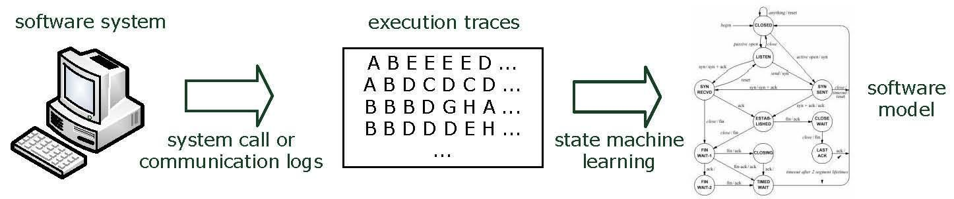
State machine learning
When a system’s design is unknown, it can be learned from data
Passive learning

Slide 5
State machine learning
When a system’s design is unknown, it can be learned from system interactions (in advanced testing & reverse engineering course)
Queries (input)
Active learning

Slide 6
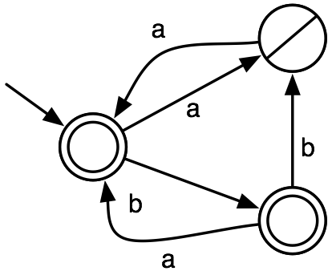
Deterministic finite state automata (DFA)
, b
(a,-),(ab,+),(aa,+),(b,+),(bb,-),(bab,+)

Slide 7
Learning DFAs from labeled data
Input:
Labeled data, positive and negative traces
Goal:
Find the smallest DFA that is consistent with the data

Slide 8
Learning DFAs from labeled data
Input:
Labeled data, positive and negative traces
Goal:
Find the smallest DFA that is consistent with the data
Occam’s razor
Among competing hypotheses, the one with the fewest assumptions should be selected.

Slide 9
Example
accept:
1 0 0 0 0 0 0 0 0
0 1 1 0 0 0 1 0 1 0 1 0 1 0 0
0 0
1 0 1 0 0
1 0 0
1 0 1
1 0 1
1 0 0 0 0 0 0
reject:
0 1 0 0 0
1 1 0 0 0 0 0 0 0 1 0 0
0 0 0 0 0 1
1 0 0 0 0 0 1 0 1 0 0 0 0 0 1 1 1 0 0 0
0 1 1 1 0 1 0 0 0 0 0 0 0
What is the smallest state machine that accepts the top and rejects the bottom strings?
Guess: how many states are needed?
Sicco Verwer

Slide 10
Example
accept:
1 0 0 0 0 0 0 0 0
0 1 1 0 0 0 1 0 1 0 1 0 1 0 0
0 0
1 0 1 0 0
1 0 0
1 0 1
1 0 1
1 0 0 0 0 0 0
reject:
0 1 0 0 0
1 1 0 0 0 0 0 0 0 1 0 0
0 0 0 0 0 1
1 0 0 0 0 0 1 0 1 0 0 0 0 0 1 1 1 0 0 0
0 1 1 1 0 1 0 0 0 0 0 0 0
Sicco Verwer

Slide 11
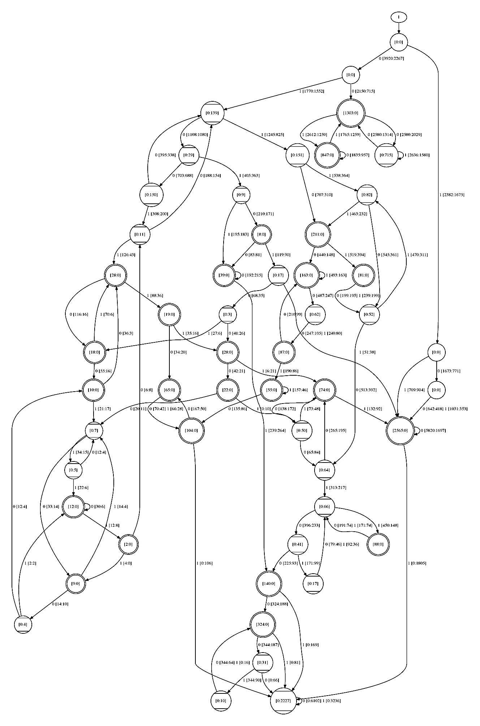
Example output by algorithm
accept:
1 0 0 0 0 0 0 0 0
0 1 1 0 0 0 1 0 1 0 1 0 1 0 0
0 0
1 0 1 0 0
1 0 0
1 0 1
1 0 1
1 0 0 0 0 0 0
reject:
0 1 0 0 0
1 1 0 0 0 0 0 0 0 1 0 0
0 0 0 0 0 1
1 0 0 0 0 0 1 0 1 0 0 0 0 0 1 1 1 0 0 0
0 1 1 1 0 1 0 0 0 0 0 0 0
… 10244 strings in total
Sicco Verwer

Slide 12
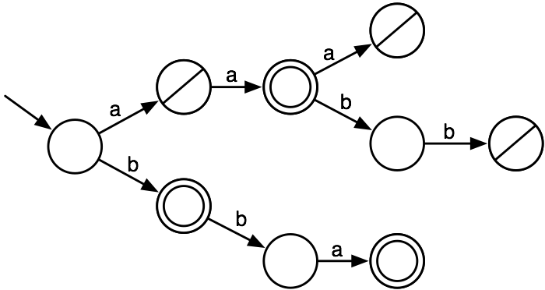
Learning DFAs
positive data: aa, b, bba; negative data: a, aaa, aabb
represented as a prefix tree

Slide 13
Learning DFAs
Now we test for a Markov property:
The past process is different for every state pair
If the future process is the same, they can be merged
i.e., when the future is independent from the past

Slide 14
Learning DFAs
Q: which states can be merged?
Now we test for a Markov property:
The past process is different for every state pair
If the future process is the same, they can be merged
i.e., when the future is independent from the past

Slide 15
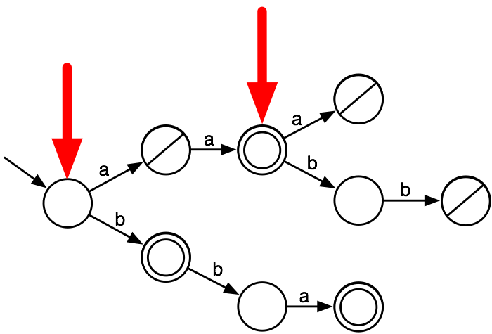
Learning DFAs
State merging:
select two nodes

Slide 16

Learning DFAs
State merging:
move input transitions from one state to the other

Slide 17

Learning DFAs
State merging:
move input transitions from one state to the other

Slide 18

Learning DFAs
State merging:
move output transitions

Slide 19
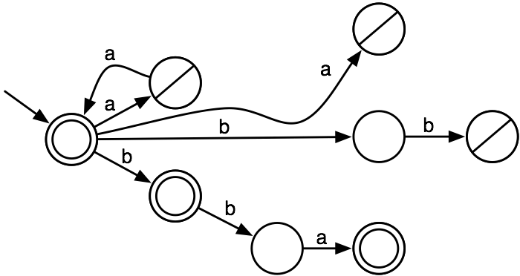
Learning DFAs
State merging:
delete the obsolete state, maintain pos/neg

Slide 20
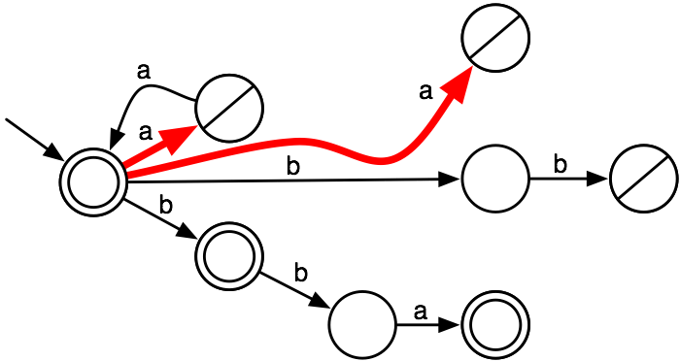
Learning DFAs
State merging:
merge targets of non-deterministic transitions

Slide 21
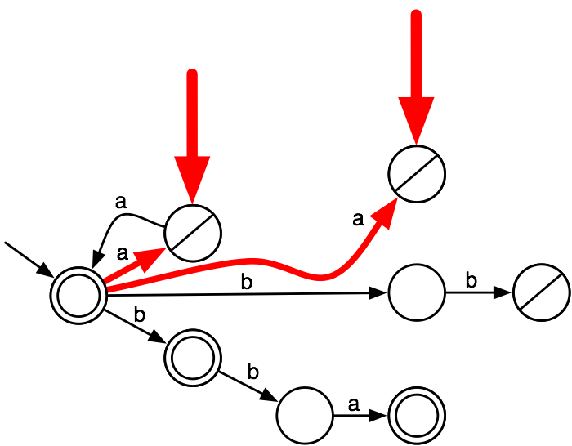
Learning DFAs
State merging:
merge targets of non-deterministic transitions

Slide 22
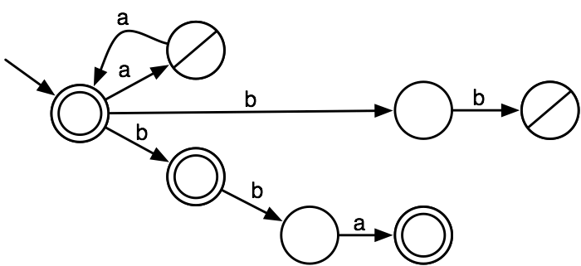
Learning DFAs
State merging:
merge targets of non-deterministic transitions

Slide 23
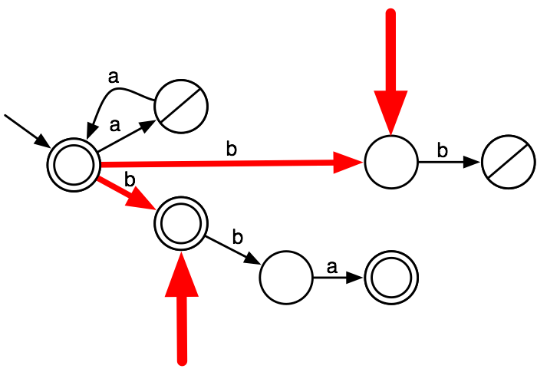
Learning DFAs
State merging:
merge targets of non-deterministic transitions

Slide 24

Learning DFAs
State merging:
merge targets of non-deterministic transitions

Slide 25
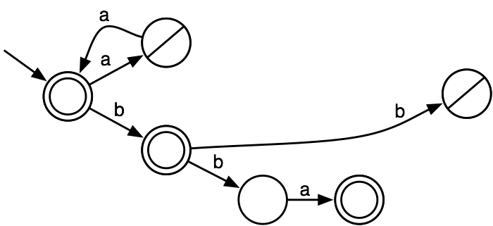
Learning DFAs
State merging:
merge targets of non-deterministic transitions

Slide 26
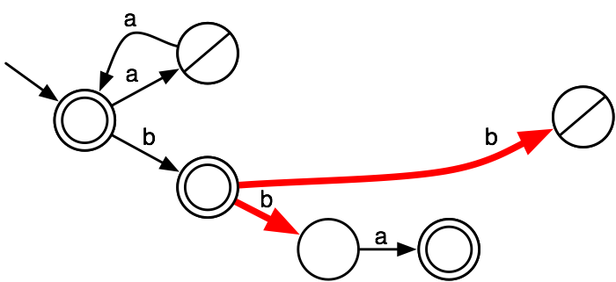
Learning DFAs
Select two new nodes to merge and iterate

Slide 27
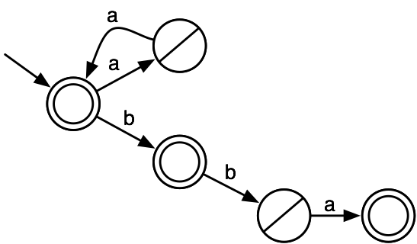
Learning DFAs
Select two new nodes to merge and iterate

Slide 28
State merging
Start from a prefix tree acceptor
For all state pairs R-B
Merge B with R
Compute a score
Undo the merge
Perform the highest scoring merge
Iterate

Slide 29
State merging
Start from a prefix tree acceptor
For all state pairs R-B
Merge B with R
Compute a score
Undo the merge
Perform the highest scoring merge
Iterate
Evidence score: number of pos-pos and neg-neg merges
Much more efficient using a shallow state first order
State-of-the-art uses satisfiability solvers [Heule and Verwer 2013]

Slide 30
Convergence
How much data does state merging need to learn
???
(_,+)
(a,-)
(b,+)
(ba,+)
(aa,+)
(ab,+)
(bb,-)
(aaa,-)
(aba,-)
(baa,-)
, b
polynomial
characteristic
set

Slide 31
Learning DFAs
What is the evidence score of this merge?

Slide 32
Probabilistic state merging
Iteratively tests the Markov assumption:
The past processes are different for state 1 and 2
If the future processes are the same, then they can be merged
In other words, they can be merged if the future is independent of the past, given the newly merged state
System logs are often unlabeled
How to test for consistency?
Solution: learn probabilistic state machines!

Slide 33
Counting transitions
3
, b
1
3
1
4
2
ab,aa,aa,b,ba,ba,bba

Slide 34
Probabilistic automata
0.75
, b
0.25
0.43
0.33
0.57
0.66
ab,aa,aa,b,ba,ba,bba

Slide 35
Probabilistic automata
Prob(aa)
=
0.43 * 0.75
=
0.3225
0.75
, b
0.25
0.43
0.33
0.57
0.66
ab,aa,aa,b,ba,ba,bba

Slide 36
Probabilistic state machine learning
Input:
Data, e.g., ab,aa,aa,b,ba,ba,bba
Goal: Find a smallest DFA that is consistent with the data
Small is:
Small number of probabilistic parameters
Consistency is:
Small distance to sample distribution
P(ab) = 1/7, P(aa) = 2/7, P(b) = 1/7, etc.

Slide 37
Model selection
Trade-off between model quality (variance) and model size (bias)
Akaike Information Criterion (AIC)
2*num_parameters – 2*log(likelihood)
Larger models result in more parameters, higher AIC
Better models result in higher likelihood, lower AIC
Goal:
Find a small good model, one with smallest AIC

Slide 38
Computing the AIC
0.75
, b
0.25
0.23
0.46
0.25
0.31
0.25
0.5

Slide 39
Computing the AIC
loglikelihood
=
sum(log probabilities)
=
log(0.23) + log(0.25) + log(0.46) +
...
parameters
=
number of transitions
=
6
0.75
, b
0.25
0.23
0.46
0.25
0.31
0.25
0.5

Slide 40
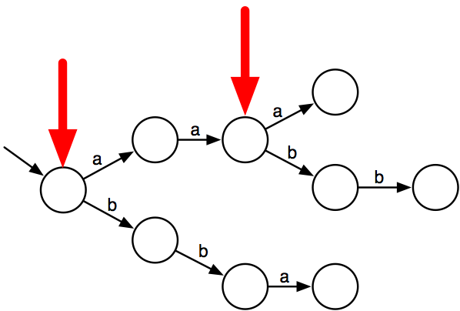
State merging with AIC
Suppose we try to merge these states

Slide 41
State merging with AIC
Compute the AIC before and after the merge
Is it a good merge?
20λ, 8a, 8aa, 8aaa, 4aab, 12aabb, 20b, 5bb, 15bba

Slide 42
State merging with AIC
Compute the AIC before and after the merge
Is it a good merge?
8
32
40
8
8
16
12
20
4
40
20
15
20
5
20λ, 8a, 8aa, 8aaa, 4aab, 12aabb, 20b, 5bb, 15bba

Slide 43
State merging with AIC
8 log(1/4)
32 log(3/4)
8 log(1/4)
40 log(2/5)
16 log(1/2)
8 log(1/4))
12 log(3/4)
20 log(1/5)
40 log(2/5)
4 log(1/4)
20 log(1/2)
15 log(1/3)
20 log(1/2)
5 log(2/3)
20λ, 8a, 8aa, 8aaa, 4aab, 12aabb, 20b, 5bb, 15bba

Slide 44
State merging with AIC
AIC = 16 – 2 * (
20log(1/5) + 80log(2/5) +
28log(1/4) + 44log(3/4) +
56log(1/2) + 5log(2/3) + 15log(1/3)
)
Approx. 445
8 log(1/4))
32 log(3/4))
8 log(1/4))
40 log(2/5))
16 log(1/2))
8 log(1/4))
12 log(3/4))
20 log(1/5))
40 log(2/5))
4 log(1/4))
20 log(1/2))
15 log(1/3))
20 log(1/2))
5 log(2/3))
20λ, 8a, 8aa, 8aaa, 4aab, 12aabb, 20b, 5bb, 15bba

Slide 45
State merging with AIC
32 log(2/3)
16 log(1/3)
48 log(48/132)
28 log(28/132)
56 log(56/132)
32 log(32/56)
24 log(24/56)
15 log(15/32)
17 log(17/32)
20λ, 8a, 8aa, 8aaa, 4aab, 12aabb, 20b, 5bb, 15bba

Slide 46
State merging with AIC
AIC = 10 – 2 * (
28log(28/132) + 48log(28/132) +
16log(1/3) + 32log(2/3) +
56log(56/132) + 24log(24/56) +
32log(32/56) + 17log(17/32) +
15log(15/32)
)
Approx. 524
32 log(2/3))
16 log(1/3))
48 log(48/132))
28 log(28/132))
56 log(56/132))
32 log(32/56))
24 log(24/56))
15 log(15/32))
17 log(17/32))
46

Slide 47
State merging
Start from a prefix tree acceptor
For all state pairs R-B
Merge B with R
Compute a score
Undo the merge
If score is positive
Perform the highest scoring merge
Iterate
Else
Return

Slide 48
State merging
Start from a prefix tree acceptor
For all state pairs R-B
Merge B with R
Compute a score
Undo the merge
If score is positive
Perform the highest scoring merge
Iterate
Else
Return
Many different score measures exist
All perform in essence a probabilistic test on a Markov assumption

Slide 49
Learning state machines
State machines are useful not only for prediction
Analysis
Verification
Control
Use model selection/Occam’s razor to handle bias-variance trade-off
In contrast to Markov chains, state information is hidden
Given a sequence abaaba, we do not immediately know the corresponding states of the system!
They are deterministic, there exists a unique path through the model for every sequence!

Slide 50
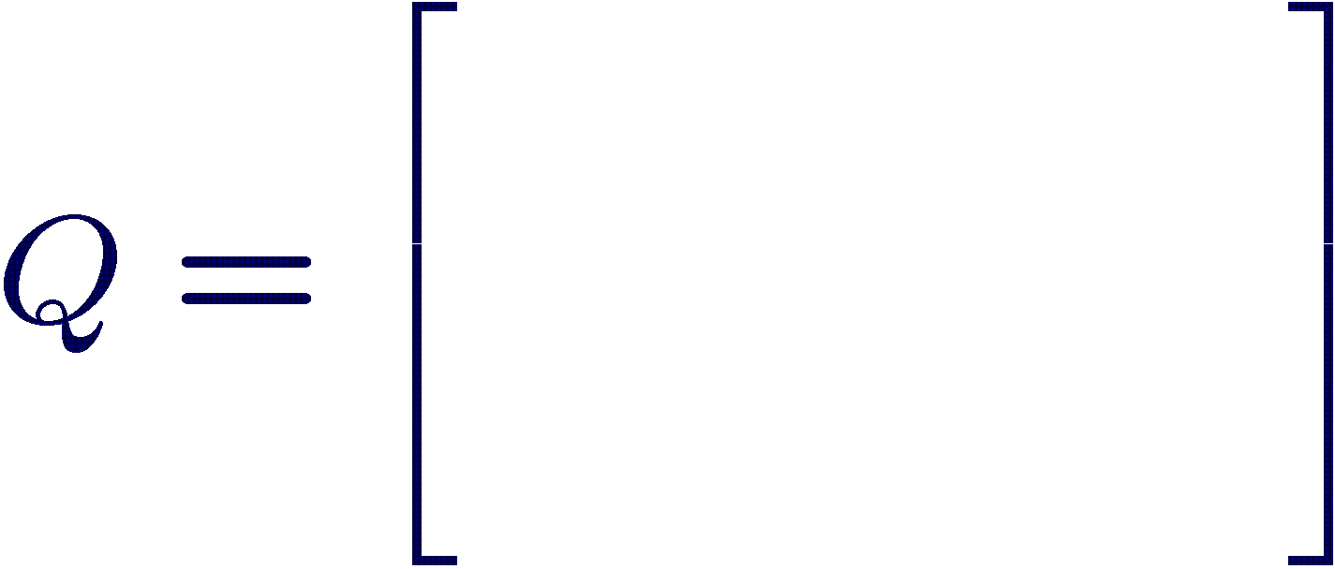
State Transition Diagrams (MCs)
0.6
0.5
0.2
0.5
0.1
0.0
1
0.9
3
0.1
0.3
0.0
0.4
0.2
0.9
0.6
2
0.3
0.4

Slide 51
State Transition Diagrams with Output Probabilities
0.6
This is a Hidden Markov Model (HMM)
Like state machines,
the state is hidden
0.5
0.2
0.5
0.1
0.0
1
0.9
3
0.1
0.3
0.0
0.4
0.2
0.9
0.6
2
0.3
0.4
P(a|1)=0.8,P(b|1)=0.2
P(a|2)=0.3,P(b|2)=0.7
P(a|3)=0.5,P(b|3)=0.5

Slide 52
State Transition Diagrams with Output Probabilities
0.6
This is a Hidden Markov Model (HMM)
Like state machines,
the state is hidden
0.5
0.2
Given the model and a sequence abbaaba
Finding the corresponding states is still hard!
0.5
0.1
0.0
1
0.9
3
0.1
0.3
0.0
0.4
0.2
0.9
0.6
2
0.3
0.4
P(a|1)=0.8,P(b|1)=0.2
P(a|2)=0.3,P(b|2)=0.7
P(a|3)=0.5,P(b|3)=0.5

Slide 53
Three key problems
Decoding:
What is the most likely hidden state sequence for an observation?
Evaluation:
How likely is an observation sequence, given a known HMM?
Learning:
What are the most likely state transition probabilities?

Slide 54
State Transition Diagrams with Output Probabilities
0.6
Given abba
There are many possible state sequences:
1111
1112
1113
1121
1123
1132
1133
…
0.5
0.2
1
0.9
3
0.1
0.3
2
0.4
P(a|1)=0.8,P(b|1)=0.2
P(a|2)=0.3,P(b|2)=0.7
P(a|3)=0.5,P(b|3)=0.5

Slide 55
State Transition Diagrams with Output and Start Probabilities
0.6
Given abba
There are many possible state sequences,
with probabilities:
1111 → 0.4*0.8*0.5*0.2*0.5*0.2*0.5*0.8
1112 → 0.4*0.8*0.5*0.2*0.5*0.2*0.3*0.3
…
0.5
0.2
1
0.9
3
0.1
0.3
2
0.4
P(1)=0.4
P(2)=0.4
P(3)=0.2
P(a|1)=0.8,P(b|1)=0.2
P(a|2)=0.3,P(b|2)=0.7
P(a|3)=0.5,P(b|3)=0.5

Slide 56
Viterbi algorithm
Dynamic programming again:
Maintain for each index i, and each state s
The maximum probability of any path ending in s at index i
 | a | b | b | a
1 | 0.4*0.8 = 0.32 | 0.32*0.5* 0.2 = 0.032 | 0.032*0.5*0.2 = 0.0032 | 0.0032*0.5*0.8 = 0.00128
2 | 0.4*0.3 = 0.12 | 0.32*0.3* 0.7 = 0.0672 | 0.054*0.4*0.7 = 0.01512 | 0.03024*0.4*0.3 = 0.00362
3 | 0.2*0.5 = 0.1 | 0.12*0.9*0.5 = 0.054 | 0.0672* 0.9*0.5 = 0.03024 | 0.03024*0.6*0.5= 0.009072
0.6
0.5
0.2
1
0.9
3
0.1
0.3
2
0.4
P(1)=0.4
P(2)=0.4
P(3)=0.2
P(a|1)=0.8,P(b|1)=0.2
P(a|2)=0.3,P(b|2)=0.7
P(a|3)=0.5,P(b|3)=0.5

Slide 57
Viterbi algorithm
Dynamic programming again:
Maintain for each index i, and each state s
The maximum probability of any path ending in s at index i
 | a | b | b | a
1 | 0.4*0.8 = 0.32 | 0.32*0.5* 0.2 = 0.032 | 0.032*0.5*0.2 = 0.0032 | 0.0032*0.5*0.8 = 0.00128
2 | 0.4*0.3 = 0.12 | 0.32*0.3* 0.7 = 0.0672 | 0.054*0.4*0.7 = 0.01512 | 0.03024*0.4*0.3 = 0.00362
3 | 0.2*0.5 = 0.1 | 0.12*0.9*0.5 = 0.054 | 0.0672* 0.9*0.5 = 0.03024 | 0.03024*0.6*0.5= 0.009072
0.6
0.5
0.2
1
0.9
3
0.1
0.3
2
0.4
P(1)=0.4
P(2)=0.4
P(3)=0.2
P(a|1)=0.8,P(b|1)=0.2
P(a|2)=0.3,P(b|2)=0.7
P(a|3)=0.5,P(b|3)=0.5

Slide 58
Viterbi algorithm
Dynamic programming again:
Maintain for each index i, and each state s
The maximum probability of any path ending in s at index i
 | a | b | b | a
1 | 0.4*0.8 = 0.32 | 0.32*0.5* 0.2 = 0.032 | 0.032*0.5*0.2 = 0.0032 | 0.0032*0.5*0.8 = 0.00128
2 | 0.4*0.3 = 0.12 | 0.32*0.3* 0.7 = 0.0672 | 0.054*0.4*0.7 = 0.01512 | 0.03024*0.4*0.3 = 0.00362
3 | 0.2*0.5 = 0.1 | 0.12*0.9*0.5 = 0.054 | 0.0672* 0.9*0.5 = 0.03024 | 0.03024*0.6*0.5= 0.009072
0.6
0.5
0.2
1
0.9
3
0.1
0.3
2
0.4
P(1)=0.4
P(2)=0.4
P(3)=0.2
P(a|1)=0.8,P(b|1)=0.2
P(a|2)=0.3,P(b|2)=0.7
P(a|3)=0.5,P(b|3)=0.5

Slide 59
Learning using Baum Welch (EM)
Forward:
Backward:
Simply dynamic programming like Viterbi, replace max by sum

Slide 60
Learning using Baum Welch (EM)
The expected number of transitions from state i to j

Slide 61
Learning using Baum Welch (EM)
The expected number of occurrences of symbol j in state i

Slide 62
Learning using Baum Welch (EM)

Slide 63
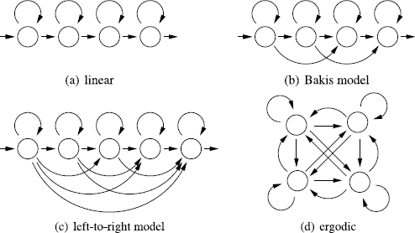
Applying HMMs
Required sequence data and HMM structure
Baum Welch only learns a given model’s parameters!

Slide 64
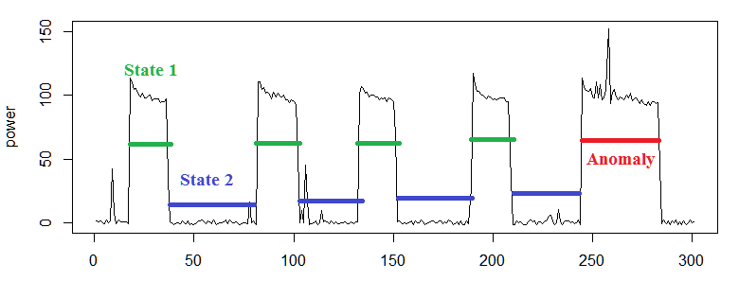
Typical application in time series
Different states represent different data distributions
Properties of these distributions can be used to detect anomalies

Slide 65
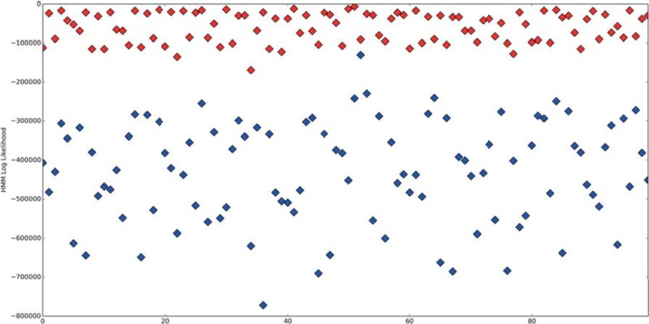
Applied to Code
Collect binaries, extract opcode sequences, learn HMMs
Intuition: code segments accessing data use different opcodes than code segments performing calculations
https://www.sciencedirect.com/science/article/pii/S0167404816300499#f0020

Slide 66
HMMs
In contrast to deterministic automata:
Calculating an observation sequence probability and fitting the transition probabilities are not easy problems!
Learning meaningful structure is very hard!
Baum Welch is a greedy optimization method, not guaranteed to find optimum! (use restarts)
HMMs are very powerful – large variance
Smoothing or other generalization method can be applied
Very many applications use HMMs for sequence modelling:
Time series, bioinformatics, speech recognition, security, …

Slide 67
HMMs vs automata
HMMs are equivalent to probabilistic non-deterministic automata
Probabilistic DFAs can only approximate an HMM distribution
Probabilistic timed automata are a type of hidden semi-Markov model

Slide 68
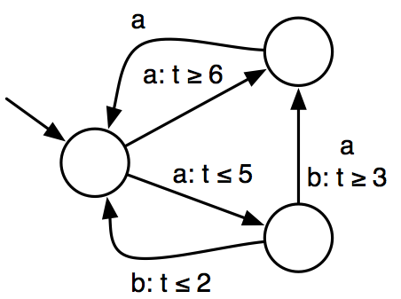
Extensions: timed automata
(a,6)(a,2)(a,3); (a,2)(b,1)(a,1)(b,8)

Slide 69
Extensions: hidden semi-Markov model
State duration modeled using probability distributions

Slide 70
Extensions: continuous HMMs
Output continuous values

Slide 71
Determinism and Interpretability
State Machine
HMM

Slide 72
Key Difference
Extensions all learned using same algorithms
Determinism: automata
Robustness to noise: HMMs
Continuous/multi-variate: HMMs (automata in development)
Guards: automata
Key difference:
Transition distribution in automata is conditioned on output
In HMMs they are independent

